Slide 1

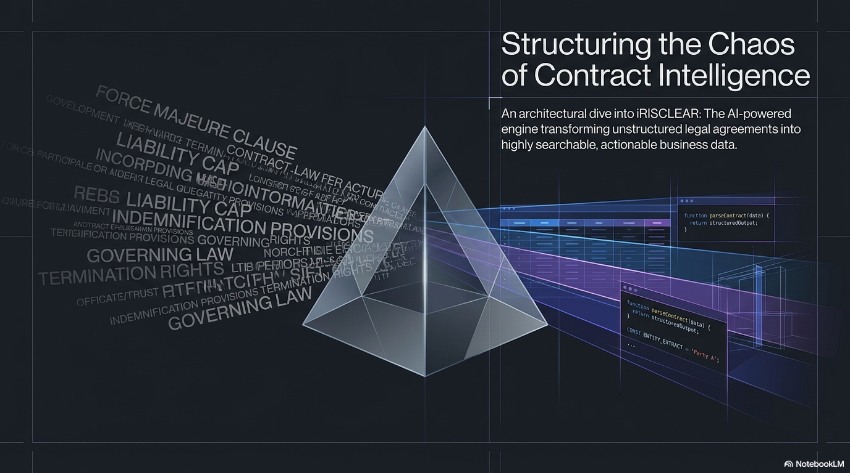

Slide 2
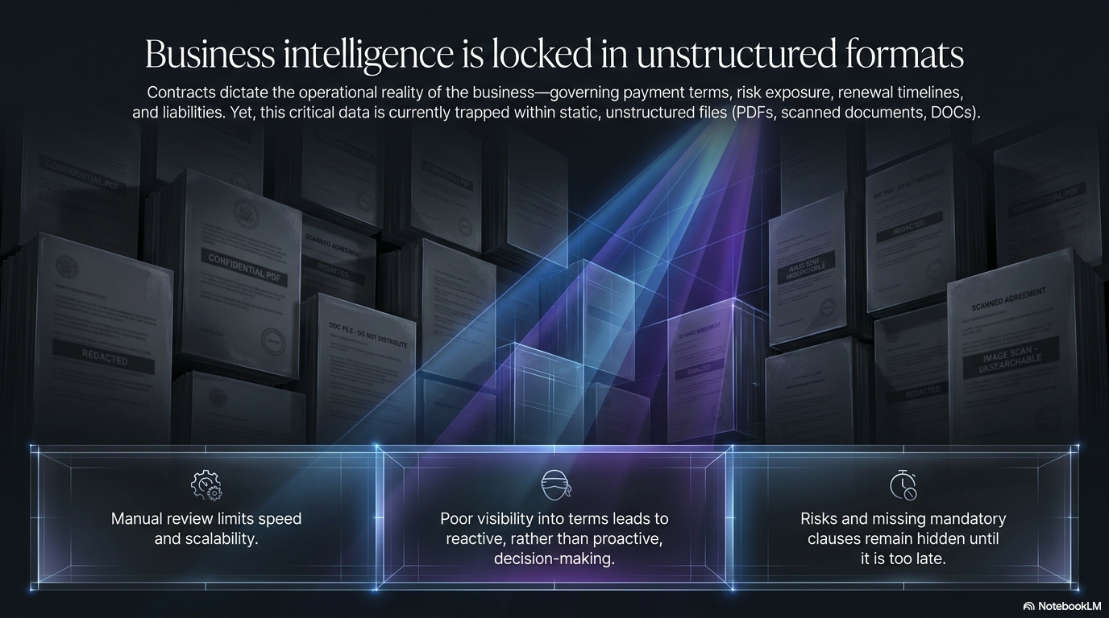

Slide 3
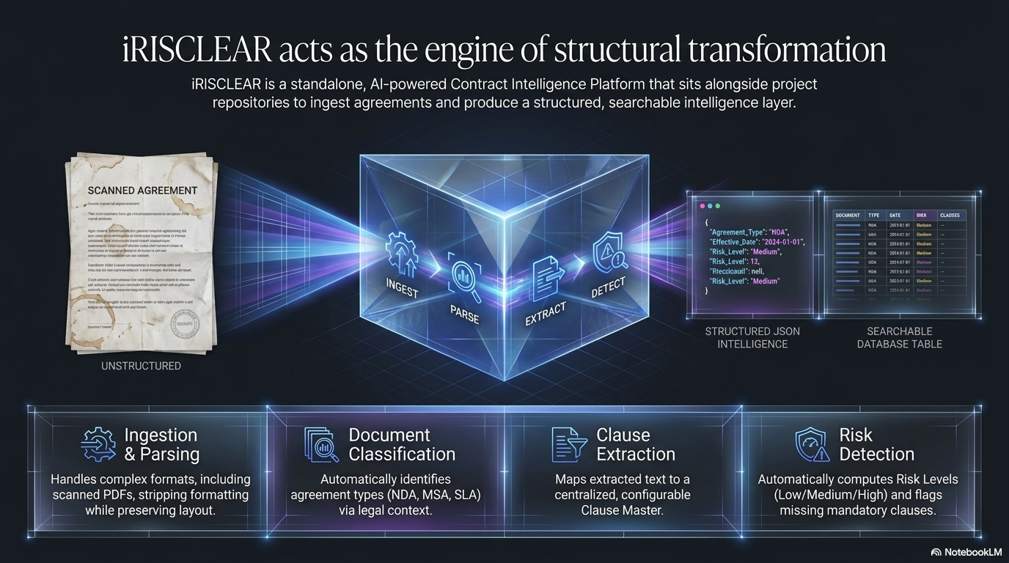

Slide 4
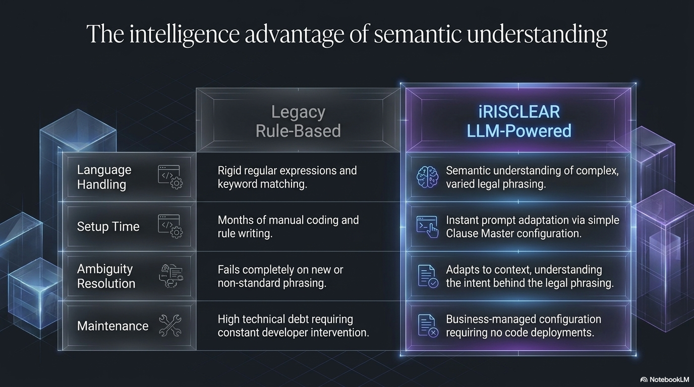

Slide 5
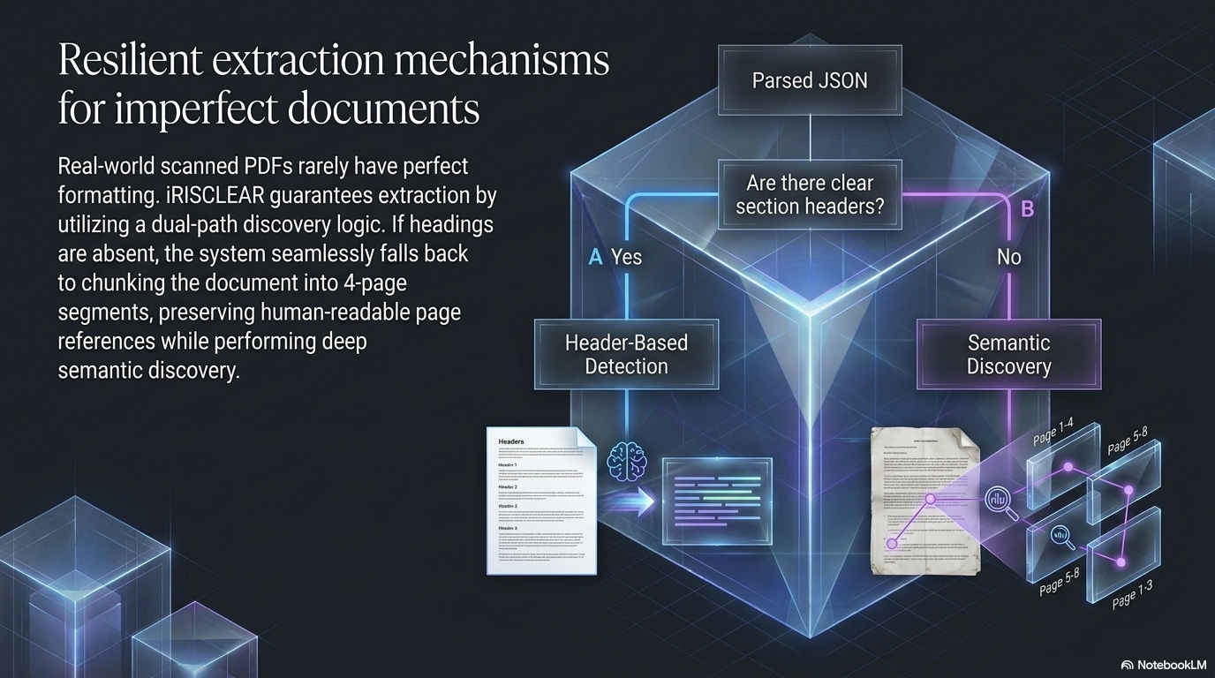

Slide 6
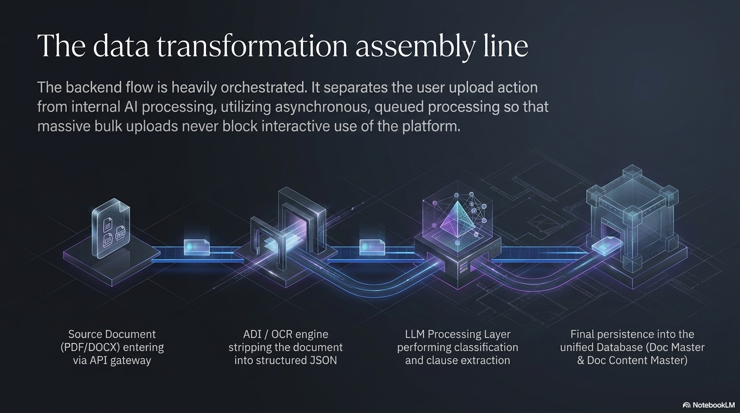

Slide 7
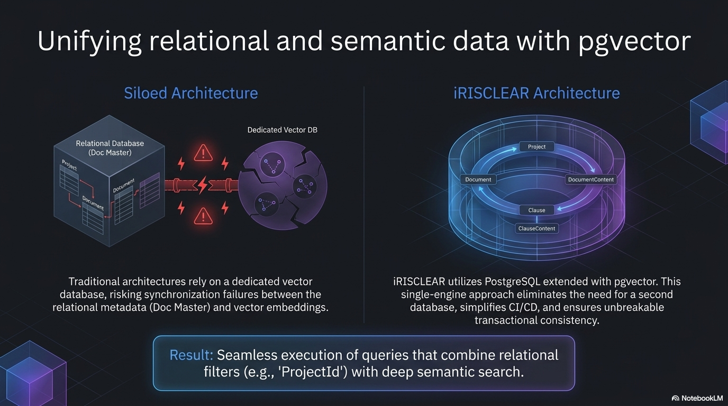

Slide 8
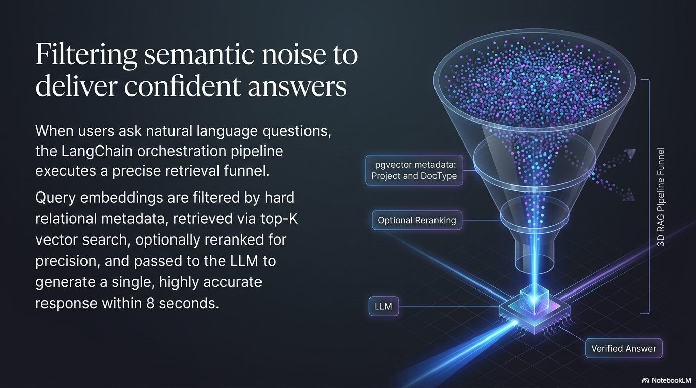

Slide 9
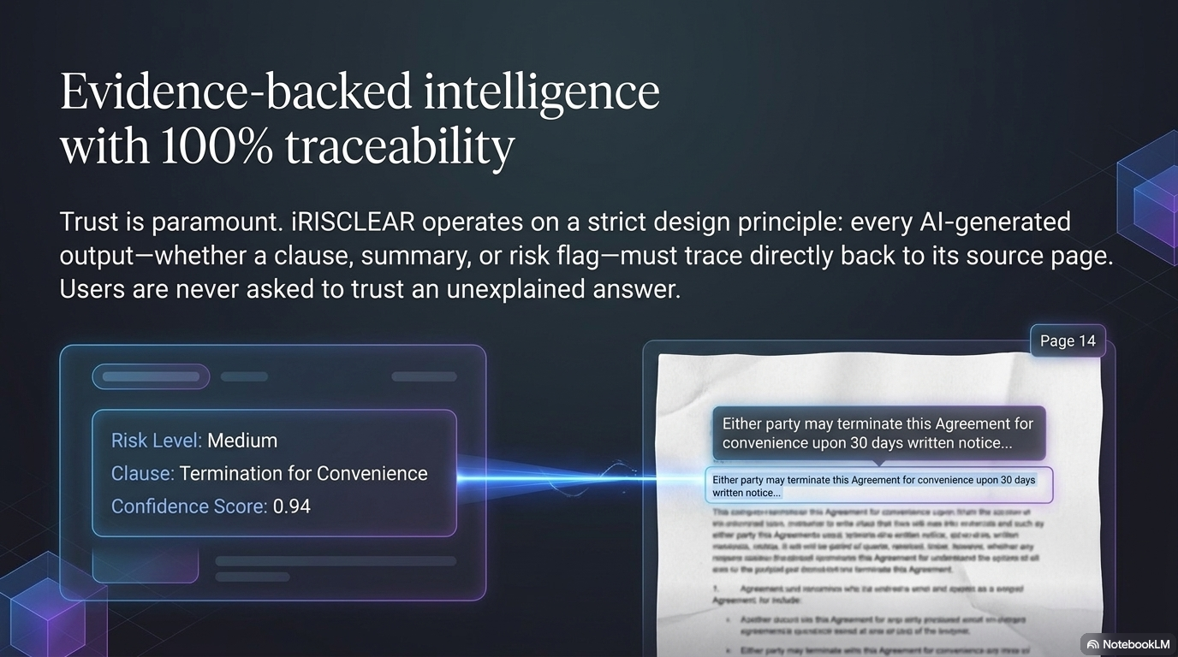

Slide 10
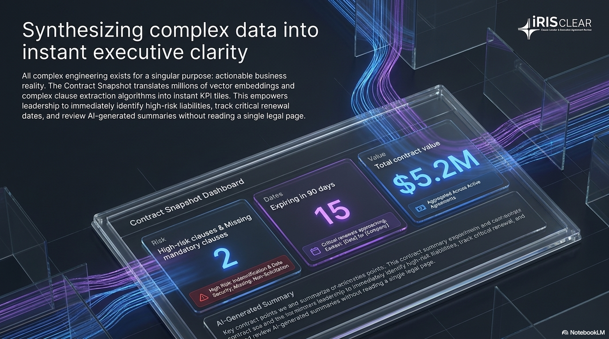

Slide 11
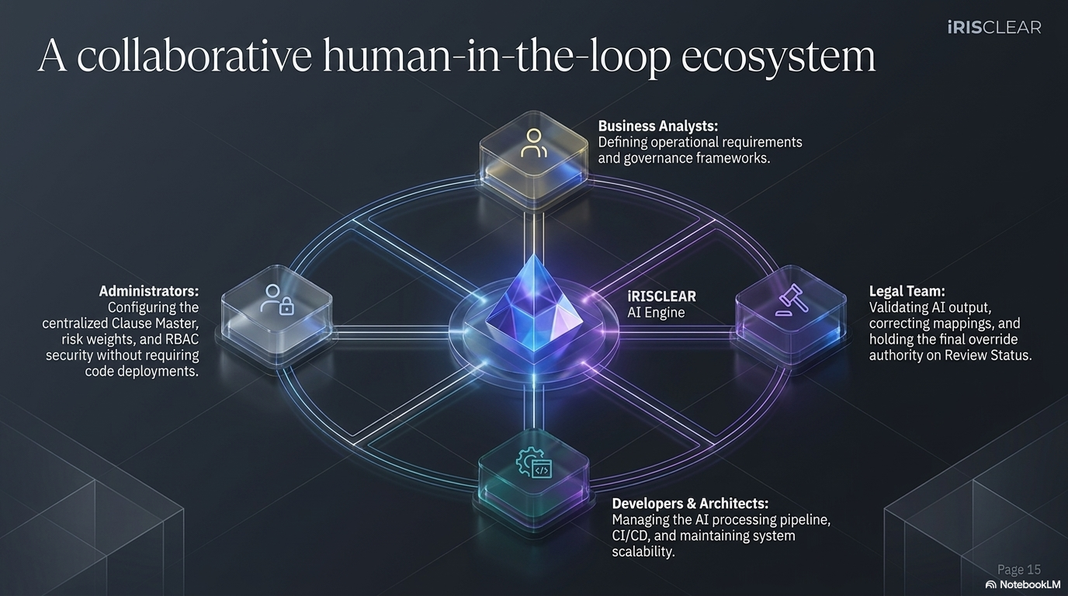

Slide 12
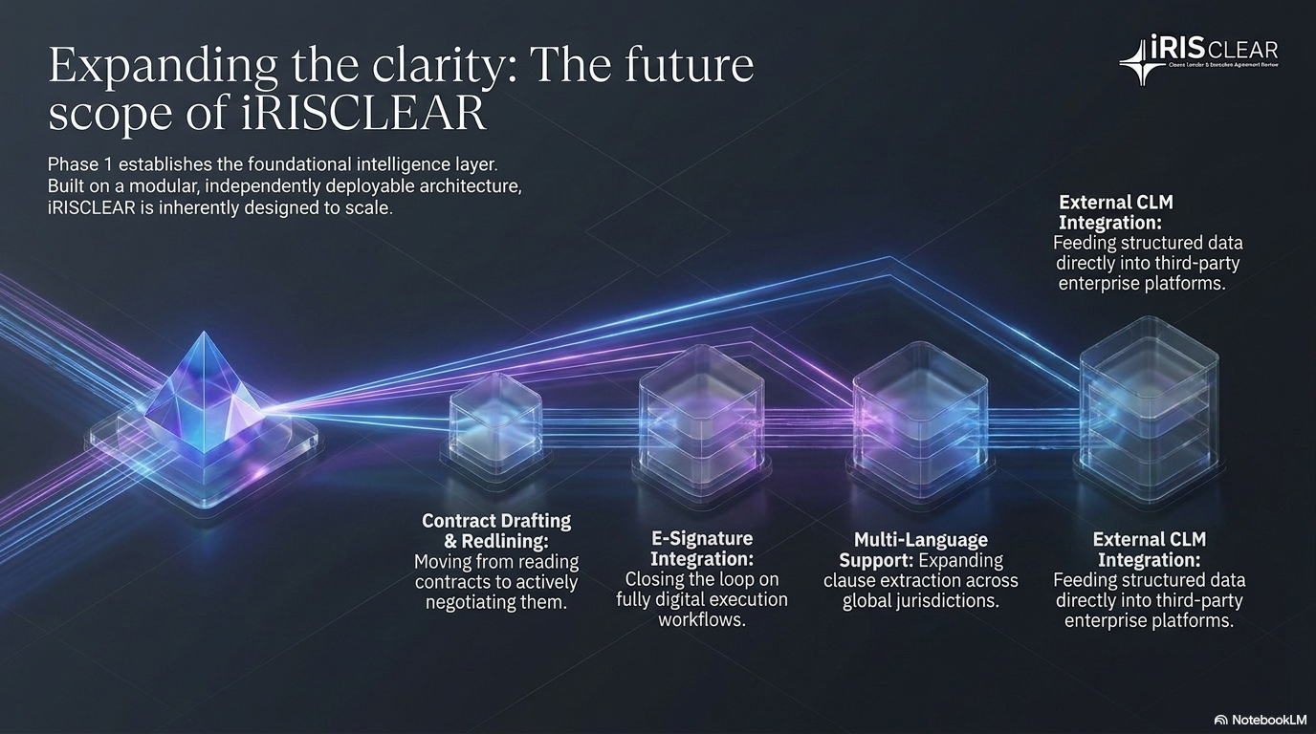

Slide 13

TEAM ELEVATE-X
Name | Role in Team (as per nomination provided) | Designation
Siddhesh Kadam | Full Stack Expert | Senior Software Engineer
Prabhakar Mhadse | Backend + AI/ML | Senior Software Engineer
Faisal Pathan | Frontend Builder | Software Engineer
Khushboo Singh | Business Analyst | Business Analyst
Chinmayi Patil | Domain SME — Regulatory | Customer Success Manager
Reena Gotal | QA Lead | Senior QA Engineer
Aashima Singh | GTM + UX/UI Design | Product & GTM Strategy

Slide 14
THANK YOU

